Slide 1

My Work
Work Experience
Education
About Me
Cover
PORTOFOLIO

Slide 2
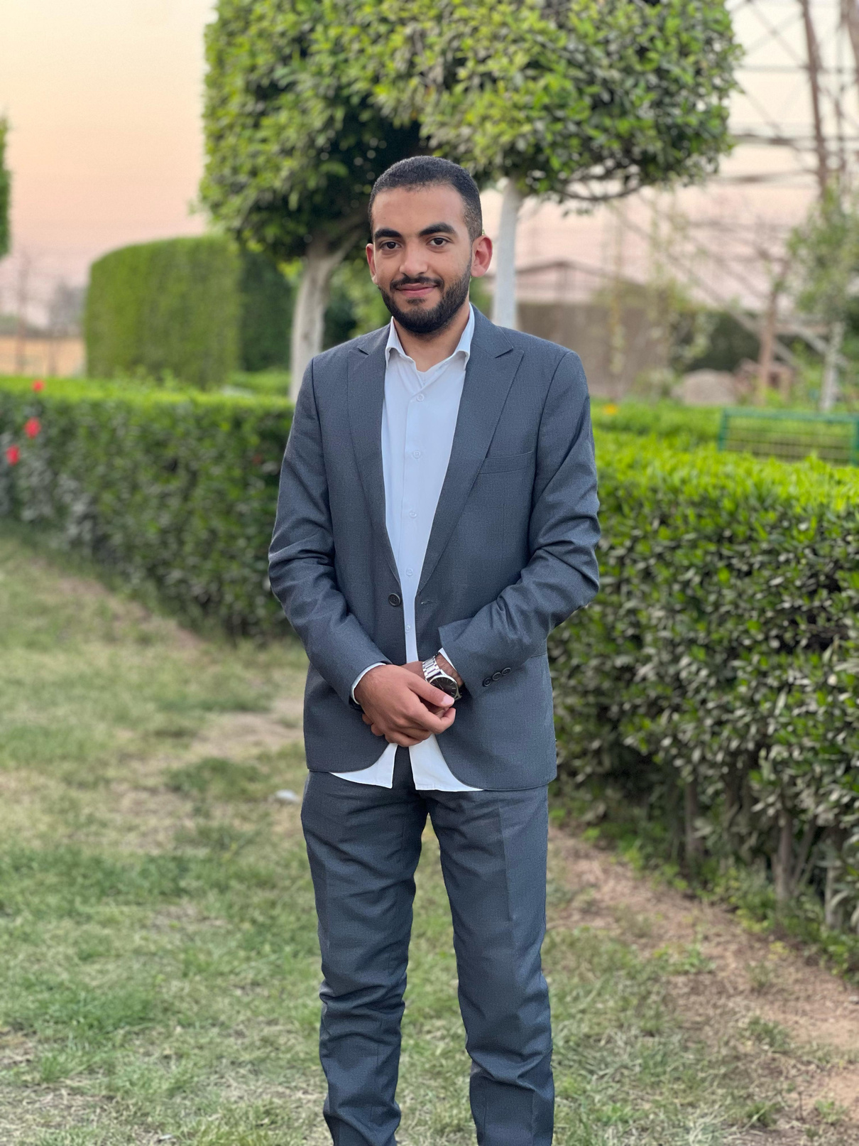
My Work
Work Experience
Education
About Me
Cover
ABOUT ME
I'm Saeed Nabil, a Communications and Electronics Engineering graduate from Zagazig Higher Institute of Engineering and Technology, class of 2025.
I'm passionate about Cloud Computing and DevOps, and currently focusing on hands-on practice in AWS, Linux, Docker, and Infrastructure as Code (IaC). I’m actively developing my technical skills through self-paced projects, labs, and professional courses to build a strong career in cloud infrastructure and automation.

Slide 3
My Work
Work Experience
Education
About Me
Cover
TECHNICAL SKILLS
Linux (Red Hat, CentOS)
AWS Cloud (EC2, S3, IAM, VPC, CloudFormation, CLI)
Bash Scripting
Python (Beginner to Intermediate)
Docker & Dockerfile
YAML
Git & GitHub
Jenkins (CI/CD basics)
Ansible (Automation)
OpenShift (DO180, DO188)
Terraform (IaC basics)

Slide 4
My Work
Work Experience
Education
About Me
Cover
CERTIFICATIONS & COURSES
AWS Academy Cloud Foundations – NTI
AWS Academy Cloud Architecting – NTI
Red Hat Linux Administration (RHCSA)
Red Hat Ansible Automation (RH294)
Red Hat OpenShift (DO180, DO188)
AWS Developer Associate – DVA-C02
AWS Cloud Security Foundations

Slide 5
My Work
Work Experience
Education
About Me
Cover
PROJECTS
🔹 AWS CLI Cloud Environment Setup
Created a full VPC with Subnets, Routing Tables, and Security Groups
Launched EC2 instance and connected to S3 using IAM Role
Automated setup via Bash script
🔹 Docker & YAML Project
Built a Dockerfile for a Python API
Created multi-container setup with YAML configurations
🔹 Bash Scripts for Automation
Automated daily backup and permission management on Linux

Slide 6
My Work
Work Experience
Education
About Me
Cover
CONTACT INFORMATION
📧 Email: saeidgebaly@gmail.com
🔗 LinkedIn: www.linkedin.com/in/saeed-gebaly-2a08691b4
📱 Phone: +20 101 253 3788

Slide 7
My Work
Work Experience
Education
About Me
Cover
THANK YOU
That's my portfolio so far.

